Slide 1

BLUE MANGOES
Piyush Khemka, Prachi Poddar, Snigdha Kamal, Sharang Bhat

Slide 2
MUSIC RECOMMENDATION
SYSTEM
Based on Million Song Dataset*
*labrosa.ee.columbia.edu/millionsong/

Slide 3
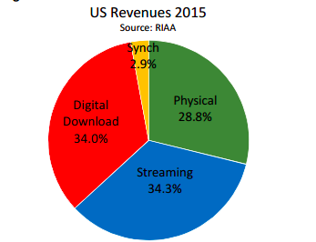
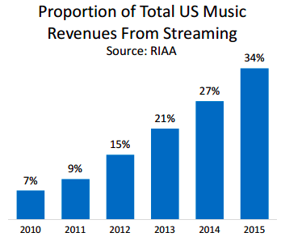








Background and Motivation
Growth in Music streaming consumption among consumers
Plethora of options available - Spotify, Pandora, 8tracks
*http://www.riaa.com/reports/riaa-2015-year-end-sales-shipments-data-report-riaa/
RIAA - Recording Industry Association of America

Slide 4
Background and Motivation
Music Recommendations - excellent feature for any music application.
Better Recommendations - Better Conversions, More engagement
Develop a music recommendation system based on the Million Song Dataset using various recommendation methodologies and draw a comparative analysis between them

Slide 5
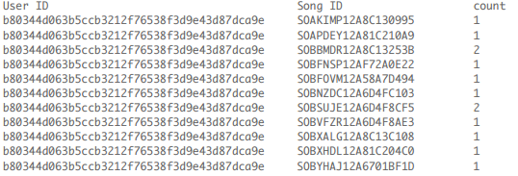
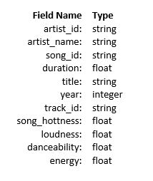
Dataset Description
The Million Song Dataset User Taste Profile Dataset
Freely available collection of audio features and metadata 48 million triplets(User Id, Song ID, count)
for a million contemporary popular music tracks ( 280 GB) Gathered from 1 million users
1 M songs.
Subset: 2.8 GB (compressed) -> 10 GB (CSV) Size: 500 MB (compressed) -> 3 GB (.txt file)

Slide 6
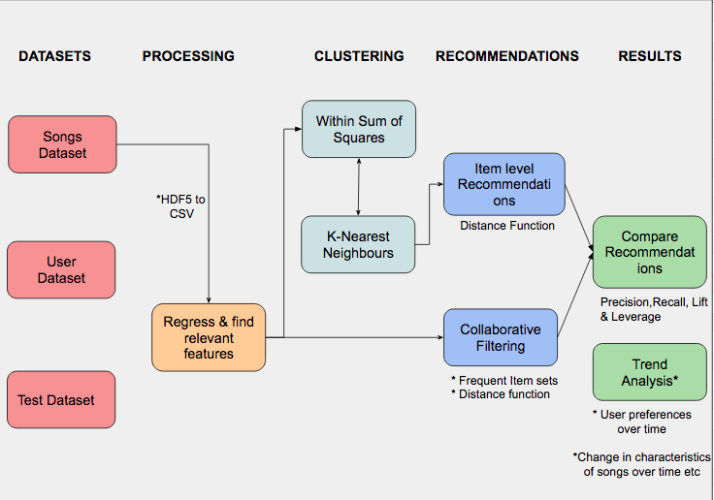
Project Pipeline

Slide 7
Collaborative Filtering
The Collaborative Filtering method uses previous user choices, and choices of similar users to predict the possible future song selections
Data was first fed through a data cleaning module, which removed erroneous entries, such as missing values for both Song and User ID’s.
ID’s were then mapped to a unique integer via a dictionary as Spark functions require numeric values
A reverse lookup RDD was created to map songs back to their original ID’s

Slide 8
Collaborative Filtering
Used Matrix Factorization instead of the conventional distance function
Latent factor methods were used to train on some known data
K User Features (latent) were extracted , which in this case was the song count
Assumption-Song Count represents all the factors that could have contributed to a user choosing to listen to a song
Trained over different values of K (ranks) and selected best rank to use for testing
Testing Method 1- Cross validation
Testing Method 2-Trained over entire set of 48 Million Users, and tested on 4 testing datasets provided

Slide 9
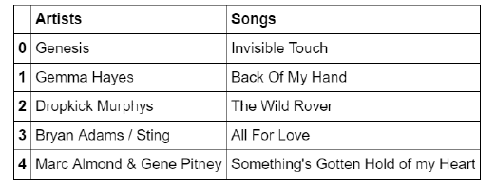
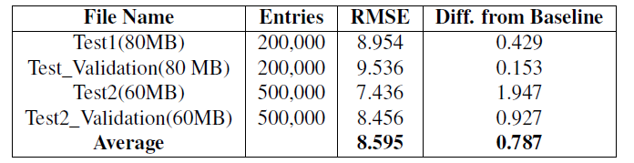
Results - Collaborative Filtering

Slide 10
Content Based Recommendation
We extracted certain features from the dataset, which describes features of a song
Normalized those features by taking its product with its confidence to get a final value, such as mode and mode confidence to get a final mode estimate
Removed features not related to audio features
Clustered songs in a higher dimensional space, and found similar songs within each cluster

Slide 11
Content Based Recommendation
Training Method- Cross Validation
User-triples dataset was split in a ratio of 80:20.
80% of the dataset was used to train a clustering model
Created a profile for each user by merging the user-song dataset
Each user profile consisted of a “mean” of all songs heard by a user in his lifetime (as per the dataset)
Clustered using K-means

Slide 12
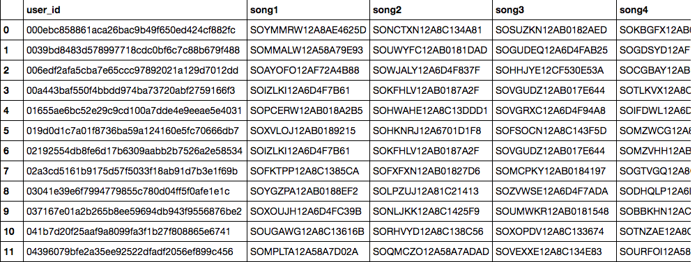
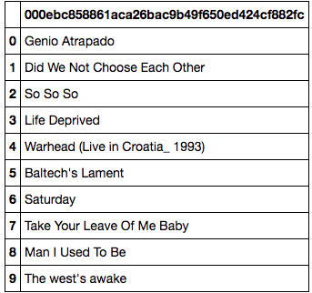
Content Based Recommendation
Testing
Generated 10 nearest neighbours for each user
Evaluated by comparing recommendations to actual values present in the dataset

Slide 13
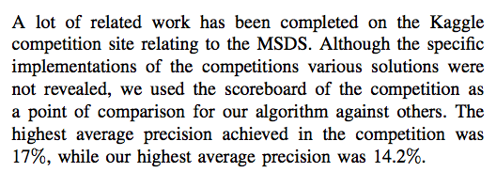
Results - Content Based Filtering
Precision = True Positives / (True Positive + False Positive)
Final Precision- 6.1% on entire MSD subset
Performance for Content Based decreases with increase in size of data
*
* http://www-personal.umich.edu/~yjli/content/projectreport.pdf

Slide 14
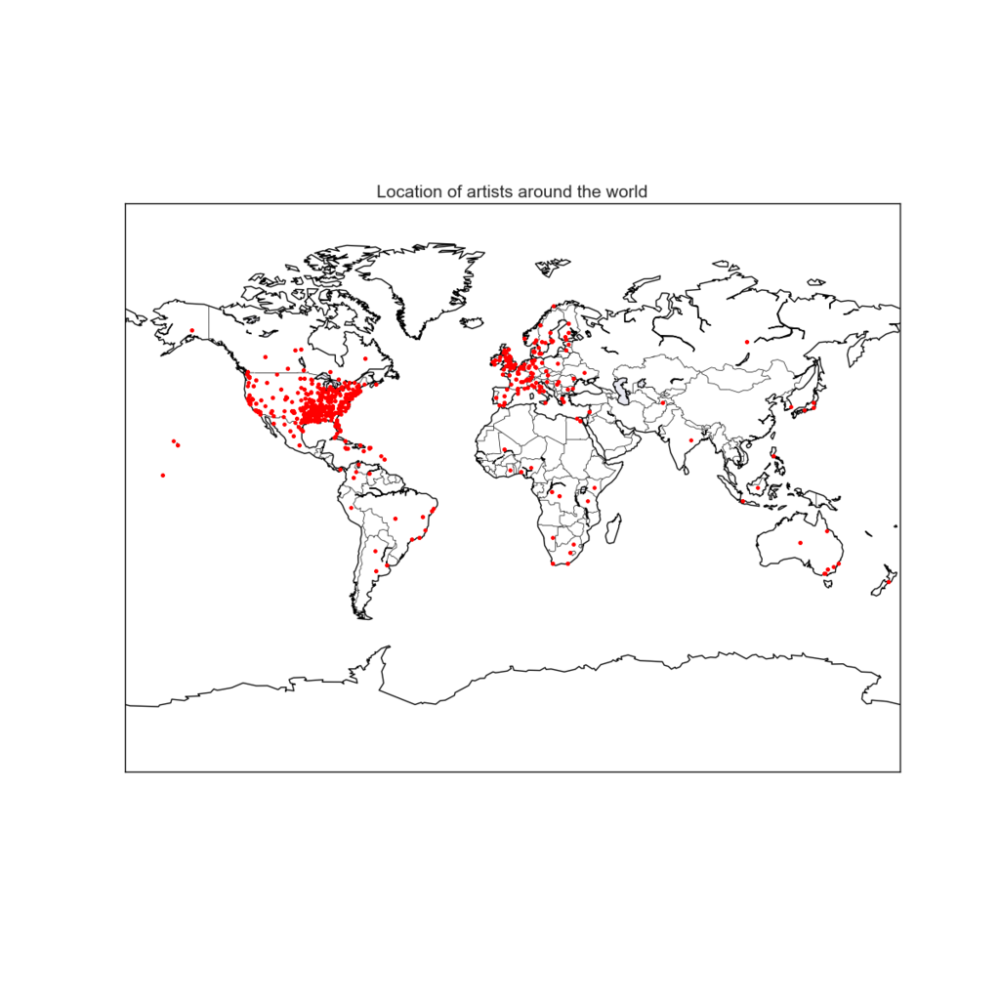
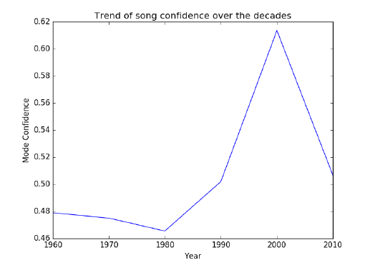
Visualizations and Trend Analysis

Slide 15
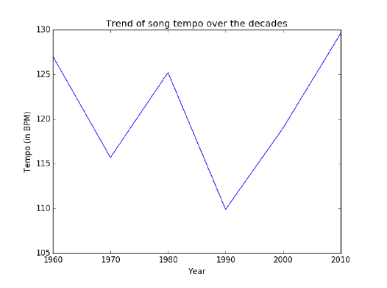
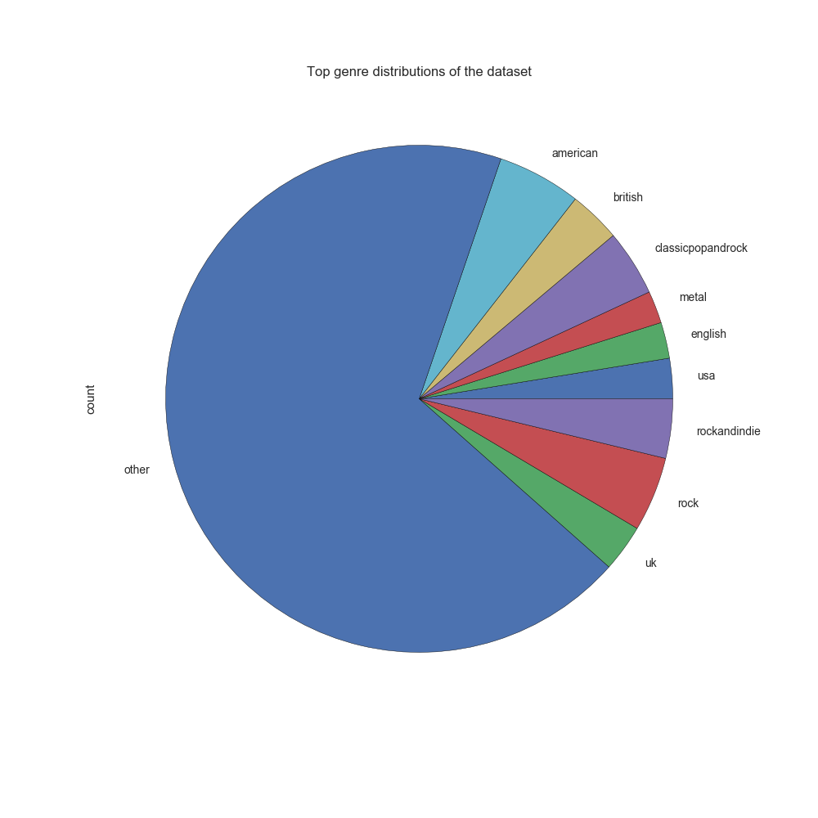
Visualizations and Trend Analysis

Slide 16
Team Work
Scoping the project, data extraction, data cleaning - All
Collaborative Filtering - Sharang
Content Based Filtering - Piyush
Trend Analysis & Visualizations - Prachi, Snigdha
Conclusion, Report, Presentation - All
Asking questions on Piazza - Anonymous

Slide 17
Conclusion
Eye opener on big data and its difficulties
We were fairly satisfied with our results, we managed to reduce the RMSE by almost 1, and virtually predicted how many times a user will play a song
We fairly satisfied with a precision of 6.1 % considering we tried a new recommendation methodology
Collaborative Filtering was easier to implement and evaluate
Unearthed some interesting music trends from across the years

Slide 18
THANK YOU

